Slide 1

Link Weight Prediction in Bitcoin OTC Trust Networks
By: Changrong Li
Zhiqiang Yu
Ziyun Pan
Manushree Tyagi
Notes:
In this presentation, we will explore a project that aims to develop a model to classify Link Weight Prediction in Bitcoin OTC Trust Networks Using Network Analysis and Deep Learning

Slide 2
Data Acquisition and Description
Dataset: Bitcoin OTC web of trust network [directed]
Data structure: Source, Target, Rating, Time
Data statistics:
Nodes: 5,881
Edges: 35,592
Rating (Link Weight) : -10 to 10
Percentage of Positive Edges: 89%
1
7
6
8
8
2
3
Notes:
Our study utilizes data from the Bitcoin OTC web of trust network, which is a directed network capturing trust relationships between users on the Bitcoin OTC platform. This dataset provides valuable insights into the trust dynamics within the community.
Data Structure
The dataset is structured with four key attributes:
Source: The user who gives the rating.
Target: The user who receives the rating.
Rating: The trust rating given by the source to the target, ranging from -10 (complete distrust) to 10 (complete trust).
Time: The timestamp when the rating was given.
Data Statistics
The dataset contains:
Nodes: 5,881 users who participate in the Bitcoin OTC platform.
Edges: 35,592 trust ratings or links between users.
Rating (Link Weight): Ratings range from -10 to 10, reflecting the level of trust or distrust.
Percentage of Positive Edges: 89% of the ratings are positive, indicating a predominantly trustful community.

Slide 3
Research Question
Motivation
Accurately predicting user trust relationships (ratings) through link weight prediction can enhance transaction security and improve user experience on the Bitcoin OTC platform.
1
7
6
8
8
2
3
?
What are the effective methods for predicting link weights in Bitcoin OTC trust networks using deep learning and traditional network analysis?
Notes:
Motivation
Imagine buying or selling Bitcoin directly with another person, bypassing traditional exchanges. This is the essence of Bitcoin OTC (Over-The-Counter) trading. However, due to the anonymity of these transactions, there's a significant challenge: how do you know you can trust the person you're dealing with?
Traditionally, online marketplaces rely on reputation systems, but these can be easily manipulated. This is where our research comes in. By accurately predicting user trust relationships (think of them as ratings), we can significantly improve the Bitcoin OTC experience.
Benefits of Link Weight Prediction
Enhanced Transaction Security: Improved User Experience:
Research Question
This brings us to the core question of our research:
What are the most effective methods for predicting link weights in Bitcoin OTC trust networks?
Here's the key: We'll leverage the power of deep learning and traditional network analysis. Link weight represents the strength of trust between users, positive for trust, negative for distrust. Deep learning excels at finding patterns in complex data, while traditional network analysis helps us understand the relationships between users within the Bitcoin OTC network.
By combining these techniques, we aim to develop a robust system for predicting trust relationships, ultimately making Bitcoin OTC transactions safer and more user-friendly.

Slide 4
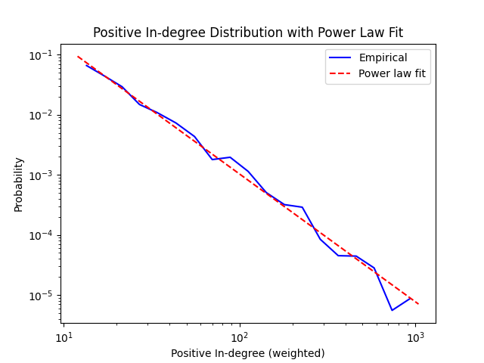
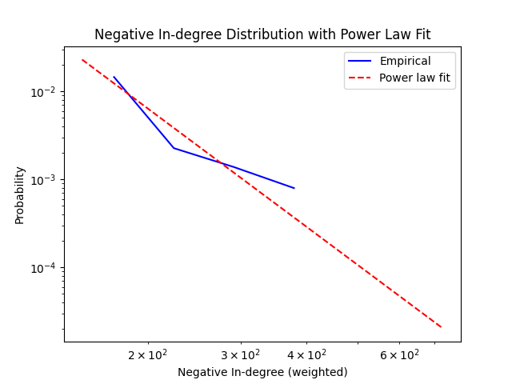
Degree Distribution: Power law
Notes:
As you can see from the graph, our positive and negative edges incoming & outgoing edges are following the power law.

Slide 5
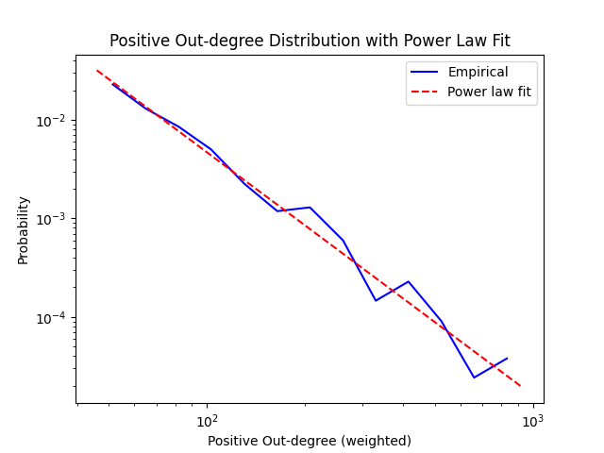
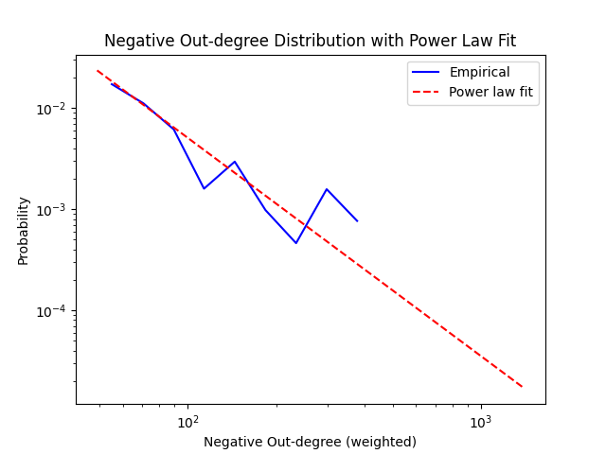
Degree Distribution: Power law

Slide 6
Proposed Methods and Algorithms
1
2
Alternating Least Squares
Deep Learning
Notes:
Now, let me introduce the community detectoin algorithm we’re about to use. The first one is Louvain algorithm.

Slide 7
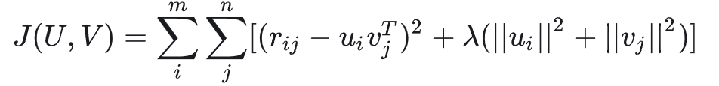
Alternating Least Squares: Pre-process & more
Since there are negative weights and degrees
& the power law distribution of positive & negative degrees differ
Points in the linear regression method:
Divide and conquer
separate the variable into sign and amplitude parts
Reduction
Relax integer programming and classification into regression tasks, MSE to assess perf.
and finally return to integers to see Accuracy
Strong interpretability
classic least squares method
theoretically supported features by social psychology
Based on supervised learning with strong explicit feedback
Notes:
Our project aims to employ a model based on the trust-weighted signed network to classify users into predefined roles within the Bitcoin ecosystem and to identify those involved in fraudulent or money laundering activities for targeted monitoring. Based on some prior knowledge, we can summarize the main roles in the blockchain as follows: Miners are central to the blockchain’s operational integrity, tasked with verifying transactions and incorporating them into blocks. Since they trade the bitcoins they mine to other users and exchanges, they typically exhibit a high out-degree. Their in-degree might be relatively low, reflecting fewer incoming transactions compared to their outputs. They generally gather high trust values from others due to their critical role in the blockchain. Exchanges act as crucial nodes that facilitate the easy exchange of cryptocurrencies for assets like fiat currencies and other digital currencies. They effectively bridge the gap between digital and traditional financial systems. Both their in-degree and out-degree are high, indicating that they are among the most connected nodes in the network. Exchanges typically maintain high trust values internally and externally due to their regulated nature and crucial role in financial transactions. Darknet Markets use cryptocurrencies to anonymize transactions for illegal goods and services, operating primarily within the hidden layers of the internet. They can exhibit both high in-degree and out-degree, as they both receive and send substantial transaction volumes. While they might have high trust values within their circles, their trust values significantly drop when interacting with external parties due to the nature of their transactions. Regular Users participate in daily transactions, utilizing cryptocurrencies for legitimate personal or business purposes. Their in-degree and out-degree may vary based on individual habits and the extent of their engagement in the cryptocurrency ecosystem. Although individual users may exhibit lower centrality in the overall network, their collective behaviour and connections through exchanges and wallet services are crucial to the cryptocurrency market dynamics. To identify potential risk user nodes, we have formulated three hypotheses regarding the existence of such nodes. These hypotheses will guide our research direction and be tested in subsequent experiments.

Slide 8
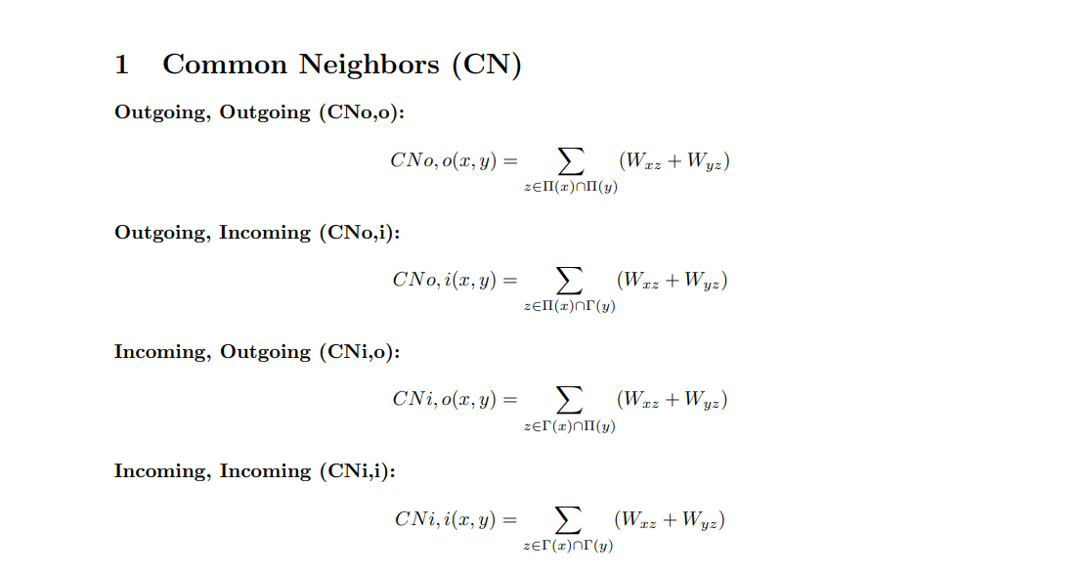
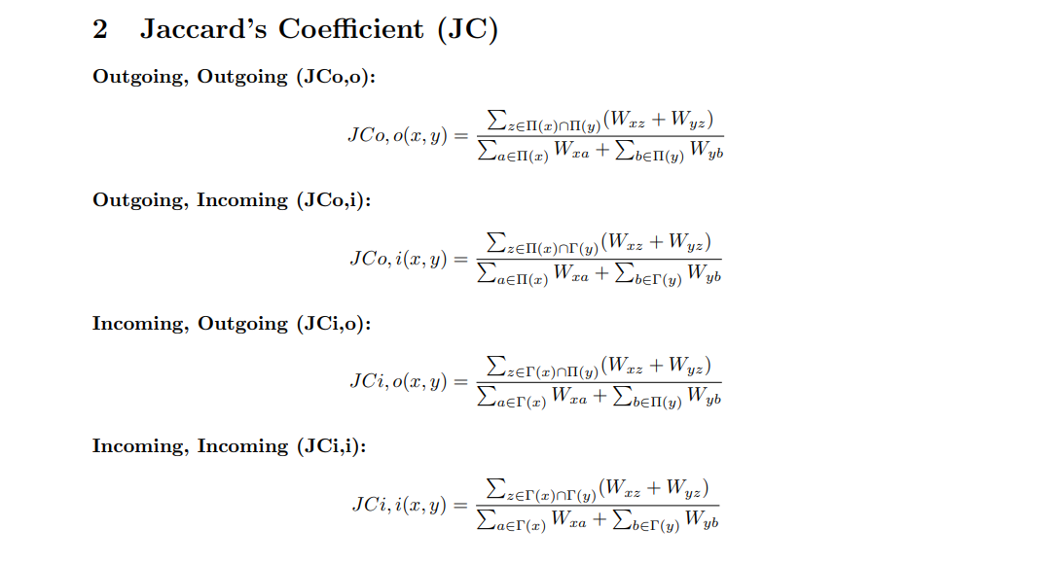

Slide 9
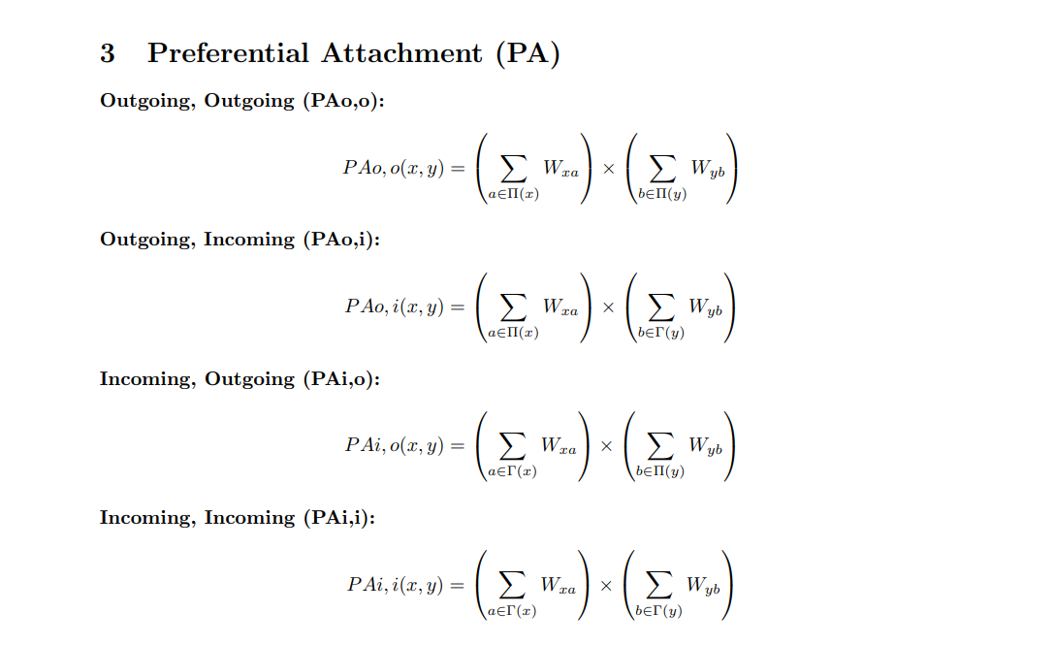
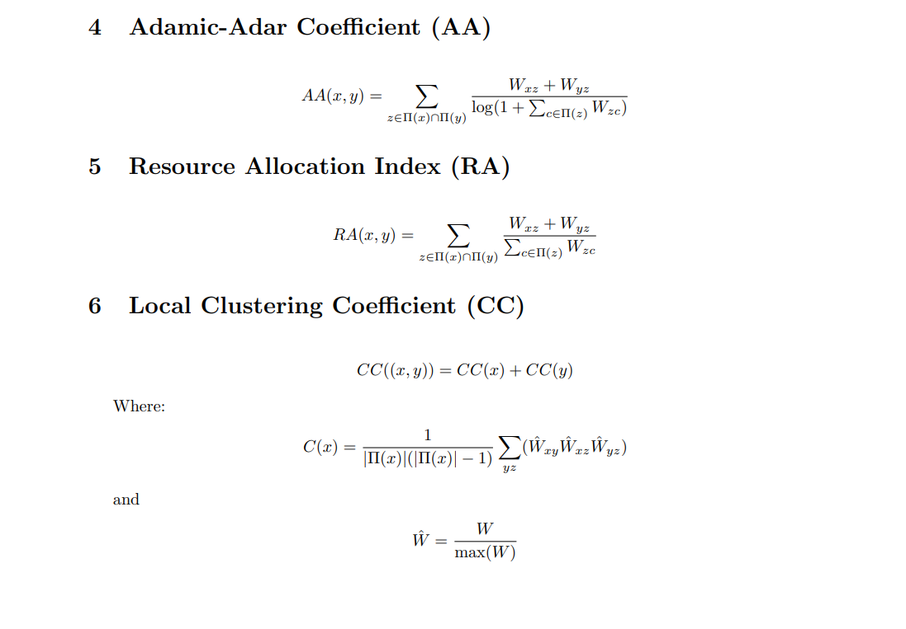

Slide 10
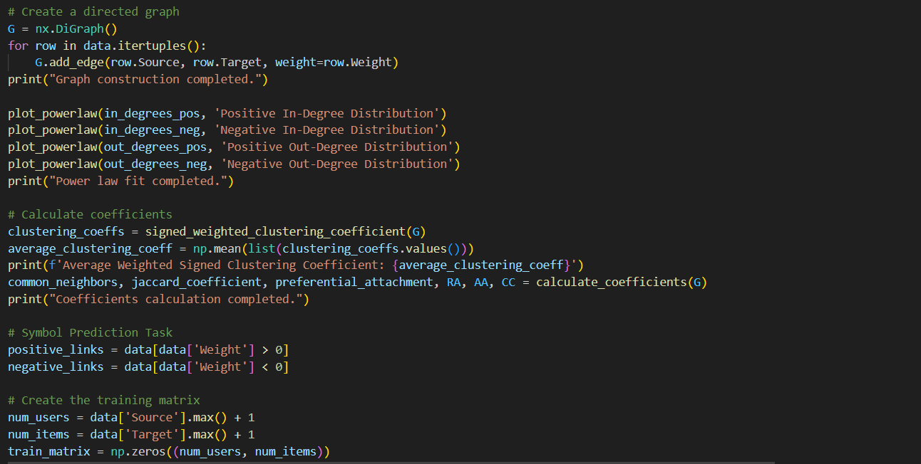
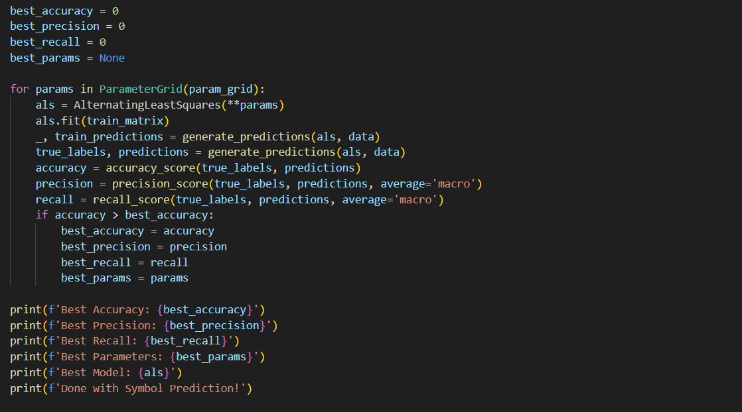

Slide 11
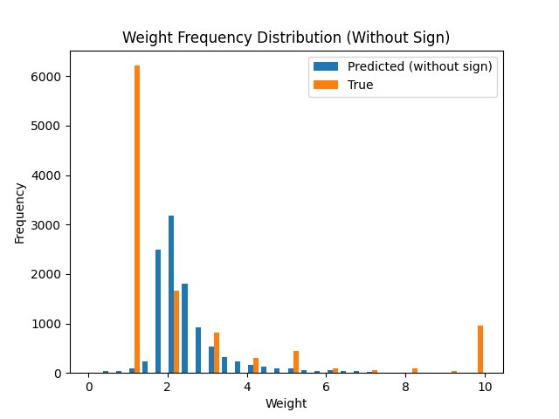
Alternating Least Squares: Result
Sign Prediction
Best Accuracy: 0.943
Best Recall: 0.731
Unsigned Weight Prediction
Mean Squared Error: 0.063
Total Signed Weight Prediction
Total Mean Squared Error: 0.125
Notes:
Our project aims to employ a model based on the trust-weighted signed network to classify users into predefined roles within the Bitcoin ecosystem and to identify those involved in fraudulent or money laundering activities for targeted monitoring. Based on some prior knowledge, we can summarize the main roles in the blockchain as follows: Miners are central to the blockchain’s operational integrity, tasked with verifying transactions and incorporating them into blocks. Since they trade the bitcoins they mine to other users and exchanges, they typically exhibit a high out-degree. Their in-degree might be relatively low, reflecting fewer incoming transactions compared to their outputs. They generally gather high trust values from others due to their critical role in the blockchain. Exchanges act as crucial nodes that facilitate the easy exchange of cryptocurrencies for assets like fiat currencies and other digital currencies. They effectively bridge the gap between digital and traditional financial systems. Both their in-degree and out-degree are high, indicating that they are among the most connected nodes in the network. Exchanges typically maintain high trust values internally and externally due to their regulated nature and crucial role in financial transactions. Darknet Markets use cryptocurrencies to anonymize transactions for illegal goods and services, operating primarily within the hidden layers of the internet. They can exhibit both high in-degree and out-degree, as they both receive and send substantial transaction volumes. While they might have high trust values within their circles, their trust values significantly drop when interacting with external parties due to the nature of their transactions. Regular Users participate in daily transactions, utilizing cryptocurrencies for legitimate personal or business purposes. Their in-degree and out-degree may vary based on individual habits and the extent of their engagement in the cryptocurrency ecosystem. Although individual users may exhibit lower centrality in the overall network, their collective behaviour and connections through exchanges and wallet services are crucial to the cryptocurrency market dynamics. To identify potential risk user nodes, we have formulated three hypotheses regarding the existence of such nodes. These hypotheses will guide our research direction and be tested in subsequent experiments.

Slide 12
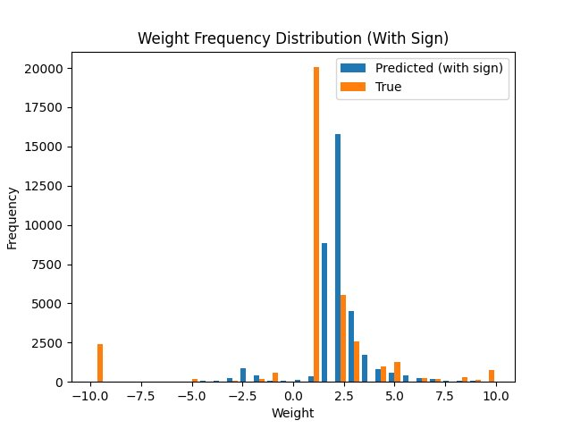
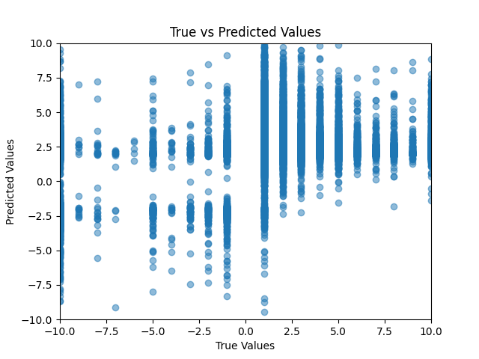
Alternating Least Squares: Result
y=x
(Predicted
=Groundtruth)
Notes:
Our project aims to employ a model based on the trust-weighted signed network to classify users into predefined roles within the Bitcoin ecosystem and to identify those involved in fraudulent or money laundering activities for targeted monitoring. Based on some prior knowledge, we can summarize the main roles in the blockchain as follows: Miners are central to the blockchain’s operational integrity, tasked with verifying transactions and incorporating them into blocks. Since they trade the bitcoins they mine to other users and exchanges, they typically exhibit a high out-degree. Their in-degree might be relatively low, reflecting fewer incoming transactions compared to their outputs. They generally gather high trust values from others due to their critical role in the blockchain. Exchanges act as crucial nodes that facilitate the easy exchange of cryptocurrencies for assets like fiat currencies and other digital currencies. They effectively bridge the gap between digital and traditional financial systems. Both their in-degree and out-degree are high, indicating that they are among the most connected nodes in the network. Exchanges typically maintain high trust values internally and externally due to their regulated nature and crucial role in financial transactions. Darknet Markets use cryptocurrencies to anonymize transactions for illegal goods and services, operating primarily within the hidden layers of the internet. They can exhibit both high in-degree and out-degree, as they both receive and send substantial transaction volumes. While they might have high trust values within their circles, their trust values significantly drop when interacting with external parties due to the nature of their transactions. Regular Users participate in daily transactions, utilizing cryptocurrencies for legitimate personal or business purposes. Their in-degree and out-degree may vary based on individual habits and the extent of their engagement in the cryptocurrency ecosystem. Although individual users may exhibit lower centrality in the overall network, their collective behaviour and connections through exchanges and wallet services are crucial to the cryptocurrency market dynamics. To identify potential risk user nodes, we have formulated three hypotheses regarding the existence of such nodes. These hypotheses will guide our research direction and be tested in subsequent experiments.

Slide 13
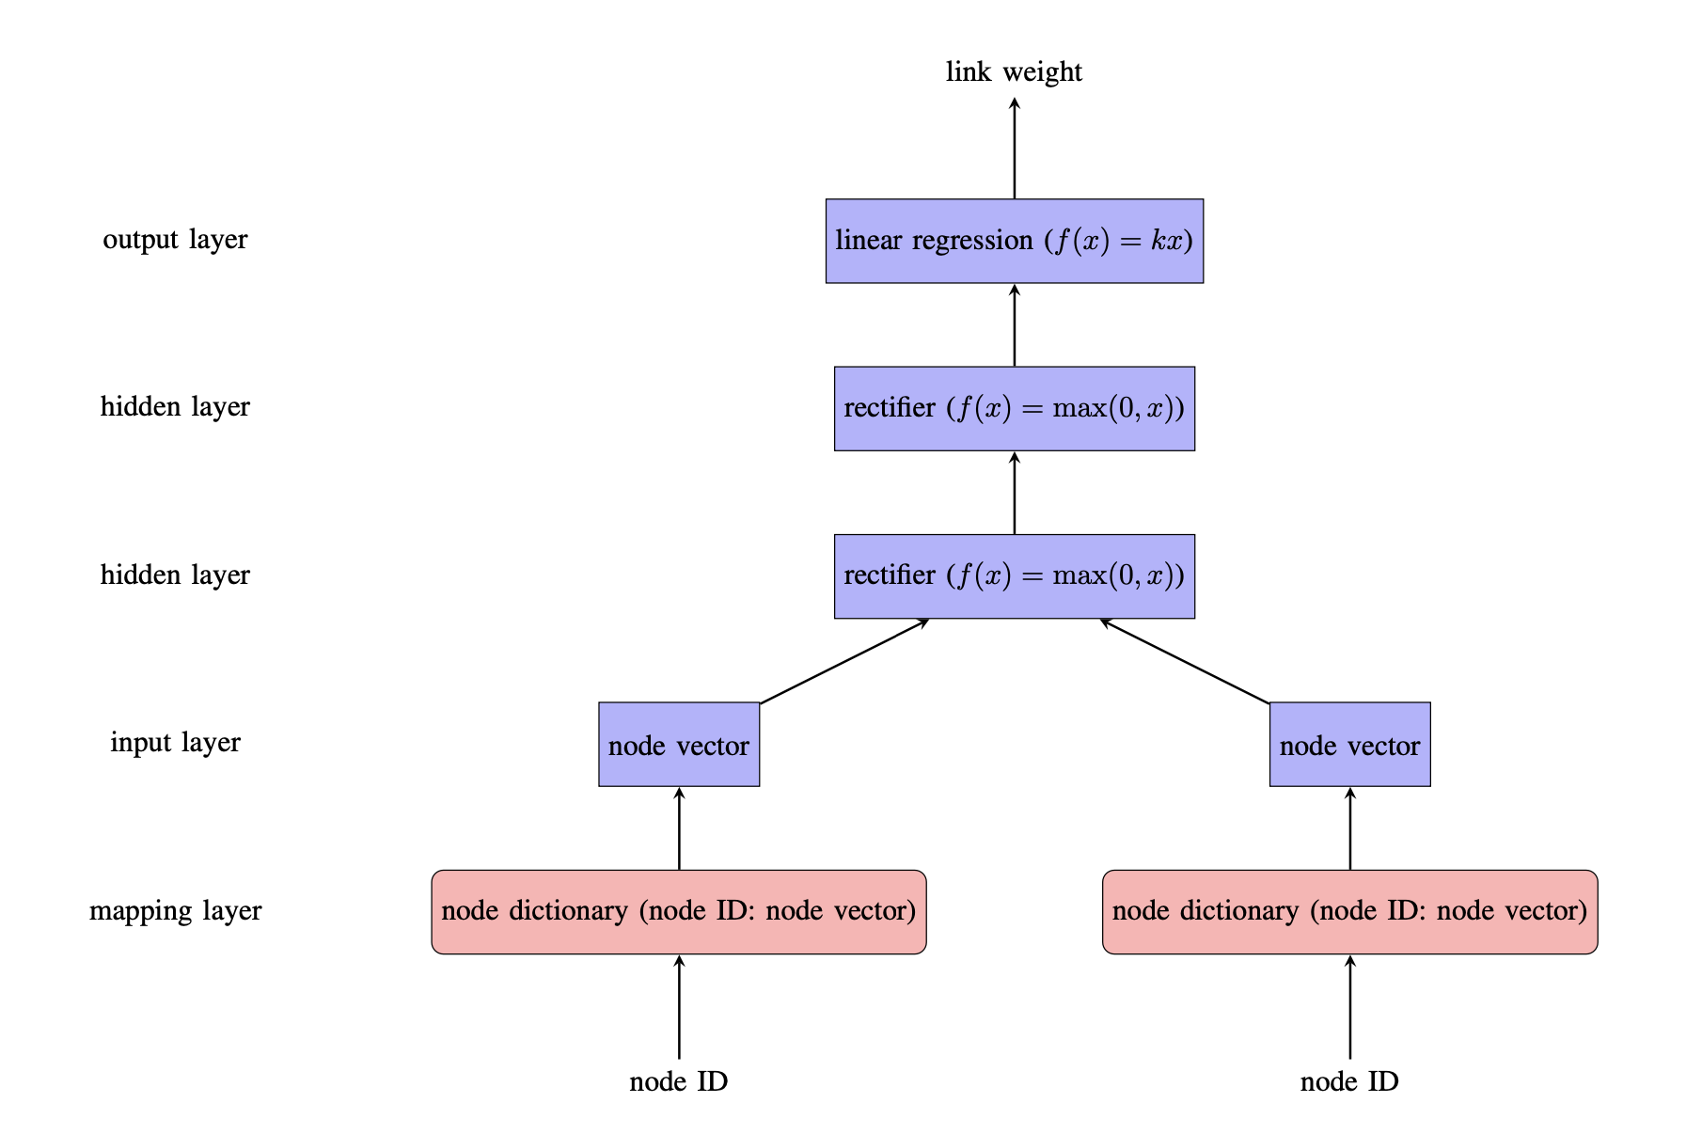
Deep Learning
Core idea:
represent entities as vectors, similar to image, audio and word
learn a node-to-vector mapping supervised by the link weight
Goal:
Update network weight
Get Node dictionary {node ID: vector}
Notes:
Our project aims to employ a model based on the trust-weighted signed network to classify users into predefined roles within the Bitcoin ecosystem and to identify those involved in fraudulent or money laundering activities for targeted monitoring. Based on some prior knowledge, we can summarize the main roles in the blockchain as follows: Miners are central to the blockchain’s operational integrity, tasked with verifying transactions and incorporating them into blocks. Since they trade the bitcoins they mine to other users and exchanges, they typically exhibit a high out-degree. Their in-degree might be relatively low, reflecting fewer incoming transactions compared to their outputs. They generally gather high trust values from others due to their critical role in the blockchain. Exchanges act as crucial nodes that facilitate the easy exchange of cryptocurrencies for assets like fiat currencies and other digital currencies. They effectively bridge the gap between digital and traditional financial systems. Both their in-degree and out-degree are high, indicating that they are among the most connected nodes in the network. Exchanges typically maintain high trust values internally and externally due to their regulated nature and crucial role in financial transactions. Darknet Markets use cryptocurrencies to anonymize transactions for illegal goods and services, operating primarily within the hidden layers of the internet. They can exhibit both high in-degree and out-degree, as they both receive and send substantial transaction volumes. While they might have high trust values within their circles, their trust values significantly drop when interacting with external parties due to the nature of their transactions. Regular Users participate in daily transactions, utilizing cryptocurrencies for legitimate personal or business purposes. Their in-degree and out-degree may vary based on individual habits and the extent of their engagement in the cryptocurrency ecosystem. Although individual users may exhibit lower centrality in the overall network, their collective behaviour and connections through exchanges and wallet services are crucial to the cryptocurrency market dynamics. To identify potential risk user nodes, we have formulated three hypotheses regarding the existence of such nodes. These hypotheses will guide our research direction and be tested in subsequent experiments.

Slide 14
Details
Learning Techniques :
Backpropagation
Stochastic Gradient Descent (SGD)
Mini-batch Gradient Descent
Early Stopping
Experiments:
25 independent trials with a random split into training (70%), validation (10%), and testing (20%) sets.
Link weights were normalized to the range [-1, 1]
Mean squared error was the metric for prediction accuracy,
Change Layer size and number of layers and repeat experiments
Notes:
Our project aims to employ a model based on the trust-weighted signed network to classify users into predefined roles within the Bitcoin ecosystem and to identify those involved in fraudulent or money laundering activities for targeted monitoring. Based on some prior knowledge, we can summarize the main roles in the blockchain as follows: Miners are central to the blockchain’s operational integrity, tasked with verifying transactions and incorporating them into blocks. Since they trade the bitcoins they mine to other users and exchanges, they typically exhibit a high out-degree. Their in-degree might be relatively low, reflecting fewer incoming transactions compared to their outputs. They generally gather high trust values from others due to their critical role in the blockchain. Exchanges act as crucial nodes that facilitate the easy exchange of cryptocurrencies for assets like fiat currencies and other digital currencies. They effectively bridge the gap between digital and traditional financial systems. Both their in-degree and out-degree are high, indicating that they are among the most connected nodes in the network. Exchanges typically maintain high trust values internally and externally due to their regulated nature and crucial role in financial transactions. Darknet Markets use cryptocurrencies to anonymize transactions for illegal goods and services, operating primarily within the hidden layers of the internet. They can exhibit both high in-degree and out-degree, as they both receive and send substantial transaction volumes. While they might have high trust values within their circles, their trust values significantly drop when interacting with external parties due to the nature of their transactions. Regular Users participate in daily transactions, utilizing cryptocurrencies for legitimate personal or business purposes. Their in-degree and out-degree may vary based on individual habits and the extent of their engagement in the cryptocurrency ecosystem. Although individual users may exhibit lower centrality in the overall network, their collective behaviour and connections through exchanges and wallet services are crucial to the cryptocurrency market dynamics. To identify potential risk user nodes, we have formulated three hypotheses regarding the existence of such nodes. These hypotheses will guide our research direction and be tested in subsequent experiments.

Slide 15
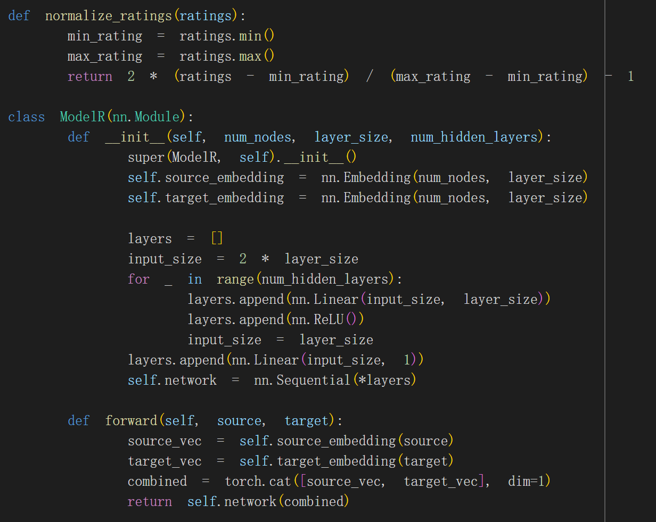
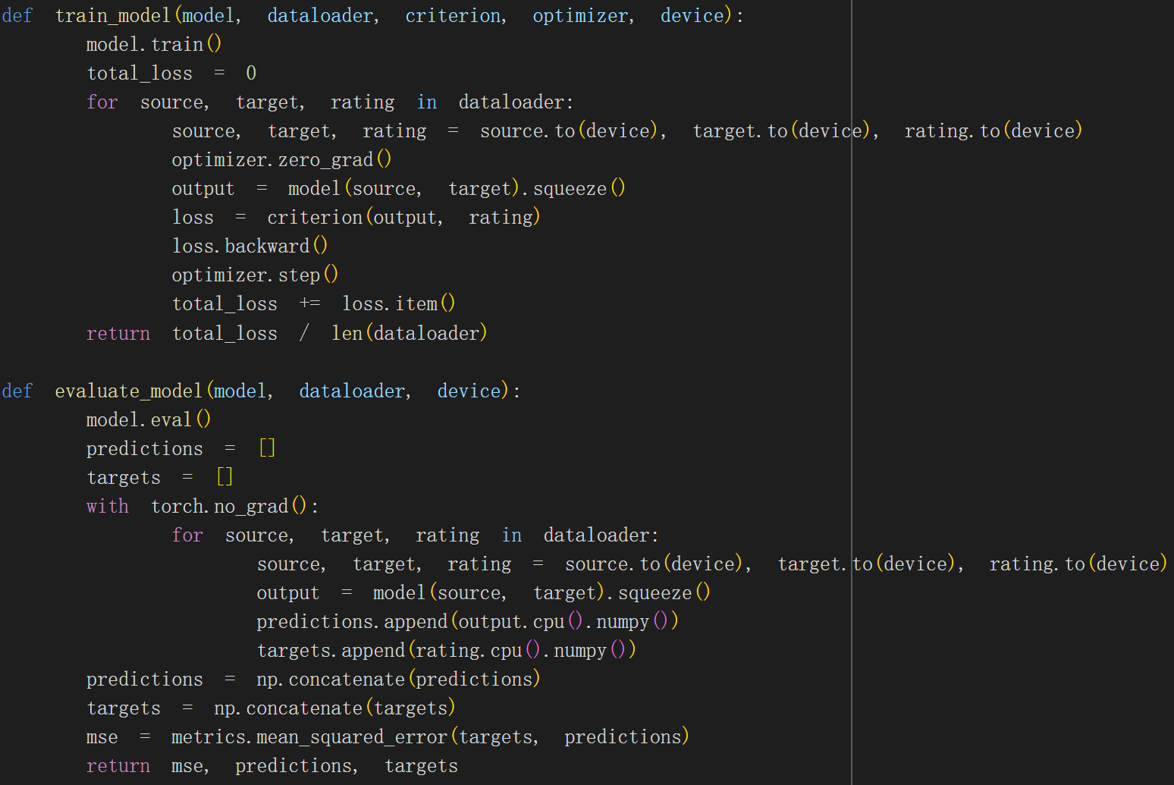
Details
Normalize Rating & Define ModelR (Using Pytorch)
Notes:
Our project aims to employ a model based on the trust-weighted signed network to classify users into predefined roles within the Bitcoin ecosystem and to identify those involved in fraudulent or money laundering activities for targeted monitoring. Based on some prior knowledge, we can summarize the main roles in the blockchain as follows: Miners are central to the blockchain’s operational integrity, tasked with verifying transactions and incorporating them into blocks. Since they trade the bitcoins they mine to other users and exchanges, they typically exhibit a high out-degree. Their in-degree might be relatively low, reflecting fewer incoming transactions compared to their outputs. They generally gather high trust values from others due to their critical role in the blockchain. Exchanges act as crucial nodes that facilitate the easy exchange of cryptocurrencies for assets like fiat currencies and other digital currencies. They effectively bridge the gap between digital and traditional financial systems. Both their in-degree and out-degree are high, indicating that they are among the most connected nodes in the network. Exchanges typically maintain high trust values internally and externally due to their regulated nature and crucial role in financial transactions. Darknet Markets use cryptocurrencies to anonymize transactions for illegal goods and services, operating primarily within the hidden layers of the internet. They can exhibit both high in-degree and out-degree, as they both receive and send substantial transaction volumes. While they might have high trust values within their circles, their trust values significantly drop when interacting with external parties due to the nature of their transactions. Regular Users participate in daily transactions, utilizing cryptocurrencies for legitimate personal or business purposes. Their in-degree and out-degree may vary based on individual habits and the extent of their engagement in the cryptocurrency ecosystem. Although individual users may exhibit lower centrality in the overall network, their collective behaviour and connections through exchanges and wallet services are crucial to the cryptocurrency market dynamics. To identify potential risk user nodes, we have formulated three hypotheses regarding the existence of such nodes. These hypotheses will guide our research direction and be tested in subsequent experiments.

Slide 16
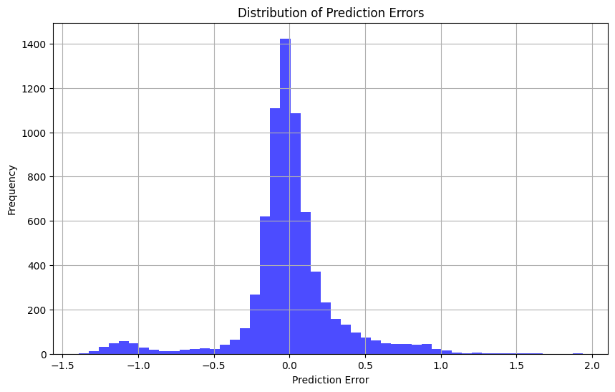
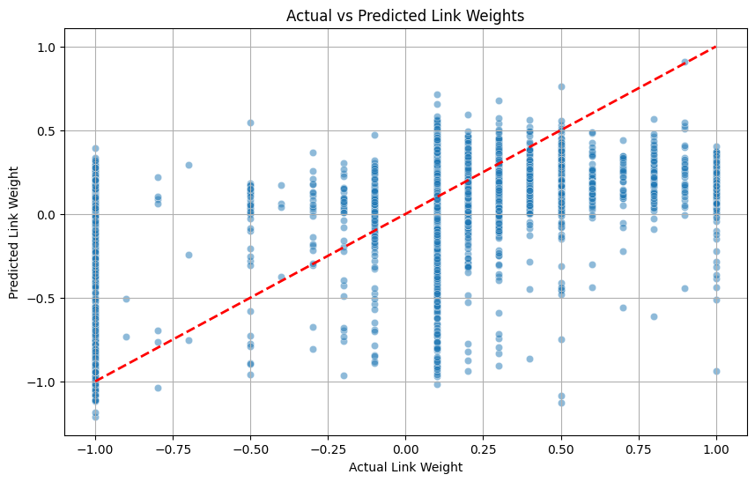
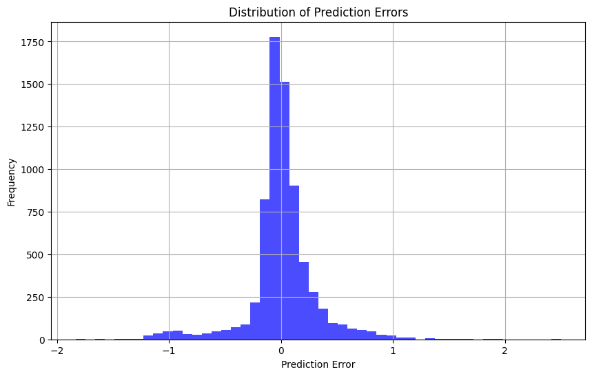
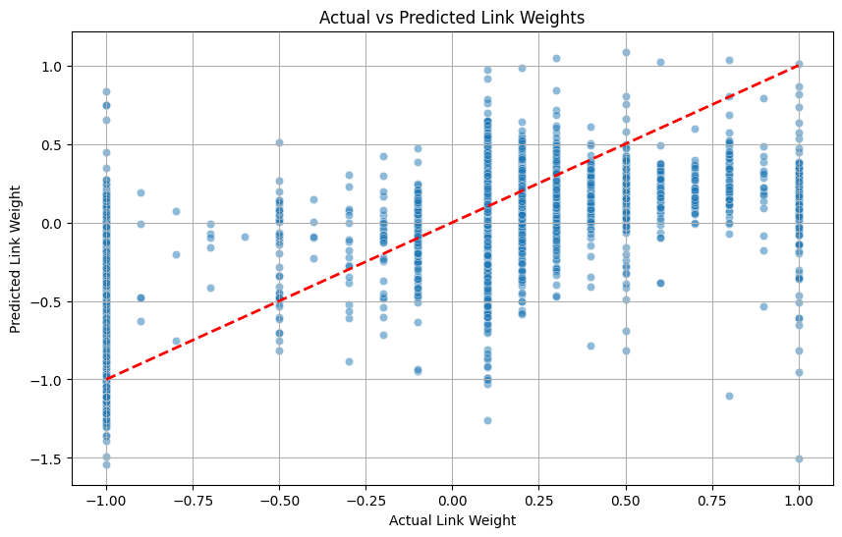
Deep Learning
y=x
(Predicted
=Groundtruth)
Results:
( Hyperparameters: Layer sizes: 14, Hidden layers: 3, Epoch: 20 )
ModelR
MSE:
0.1026
Distribution of Prediction Errors
Actual vs Predicted Link Weights
Trans-
former
MSE:
0.0928
Notes:
Our project aims to employ a model based on the trust-weighted signed network to classify users into predefined roles within the Bitcoin ecosystem and to identify those involved in fraudulent or money laundering activities for targeted monitoring. Based on some prior knowledge, we can summarize the main roles in the blockchain as follows: Miners are central to the blockchain’s operational integrity, tasked with verifying transactions and incorporating them into blocks. Since they trade the bitcoins they mine to other users and exchanges, they typically exhibit a high out-degree. Their in-degree might be relatively low, reflecting fewer incoming transactions compared to their outputs. They generally gather high trust values from others due to their critical role in the blockchain. Exchanges act as crucial nodes that facilitate the easy exchange of cryptocurrencies for assets like fiat currencies and other digital currencies. They effectively bridge the gap between digital and traditional financial systems. Both their in-degree and out-degree are high, indicating that they are among the most connected nodes in the network. Exchanges typically maintain high trust values internally and externally due to their regulated nature and crucial role in financial transactions. Darknet Markets use cryptocurrencies to anonymize transactions for illegal goods and services, operating primarily within the hidden layers of the internet. They can exhibit both high in-degree and out-degree, as they both receive and send substantial transaction volumes. While they might have high trust values within their circles, their trust values significantly drop when interacting with external parties due to the nature of their transactions. Regular Users participate in daily transactions, utilizing cryptocurrencies for legitimate personal or business purposes. Their in-degree and out-degree may vary based on individual habits and the extent of their engagement in the cryptocurrency ecosystem. Although individual users may exhibit lower centrality in the overall network, their collective behaviour and connections through exchanges and wallet services are crucial to the cryptocurrency market dynamics. To identify potential risk user nodes, we have formulated three hypotheses regarding the existence of such nodes. These hypotheses will guide our research direction and be tested in subsequent experiments.

Slide 17
Conclusion
Model Performance: Deep learning model outperforms the traditional in terms of prediction accuracy
Applicability: Deep learning methods provide a more robust and accurate solution compared to traditional network analysis techniques
Relationship Learning: Embedding methods in deep learning can better learn the relationships between nodes, leading to more accurate weight prediction results.
Supervised method: Linear Regression​ MSE 0.125
Deep Learning: Transformer MSE 0.0928
Notes:
Our project aims to employ a model based on the trust-weighted signed network to classify users into predefined roles within the Bitcoin ecosystem and to identify those involved in fraudulent or money laundering activities for targeted monitoring. Based on some prior knowledge, we can summarize the main roles in the blockchain as follows: Miners are central to the blockchain’s operational integrity, tasked with verifying transactions and incorporating them into blocks. Since they trade the bitcoins they mine to other users and exchanges, they typically exhibit a high out-degree. Their in-degree might be relatively low, reflecting fewer incoming transactions compared to their outputs. They generally gather high trust values from others due to their critical role in the blockchain. Exchanges act as crucial nodes that facilitate the easy exchange of cryptocurrencies for assets like fiat currencies and other digital currencies. They effectively bridge the gap between digital and traditional financial systems. Both their in-degree and out-degree are high, indicating that they are among the most connected nodes in the network. Exchanges typically maintain high trust values internally and externally due to their regulated nature and crucial role in financial transactions. Darknet Markets use cryptocurrencies to anonymize transactions for illegal goods and services, operating primarily within the hidden layers of the internet. They can exhibit both high in-degree and out-degree, as they both receive and send substantial transaction volumes. While they might have high trust values within their circles, their trust values significantly drop when interacting with external parties due to the nature of their transactions. Regular Users participate in daily transactions, utilizing cryptocurrencies for legitimate personal or business purposes. Their in-degree and out-degree may vary based on individual habits and the extent of their engagement in the cryptocurrency ecosystem. Although individual users may exhibit lower centrality in the overall network, their collective behaviour and connections through exchanges and wallet services are crucial to the cryptocurrency market dynamics. To identify potential risk user nodes, we have formulated three hypotheses regarding the existence of such nodes. These hypotheses will guide our research direction and be tested in subsequent experiments.

Slide 18

THANK YOU!
CRYPTO
Do you have any questions?
References:
1.Y. Hou and L. B. Holder, "Deep learning approach to link weight prediction," 2017 International Joint Conference on Neural Networks (IJCNN), Anchorage, AK, USA, 2017, pp. 1855-1862, doi: 10.1109/IJCNN.2017.7966076.
2. Kumar, Akshay, and Vincent Ying. "Network Analysis of Weighted Signed Bitcoin Networks." CS 224W Project Report, 11 Dec. 2017, https://snap.stanford.edu/class/cs224w-2017/projects/cs224w-67-final.pdf.
CRYPTO

